Slide 1


Products Manufacturing
KTC
Kan Tsang Group

Slide 2
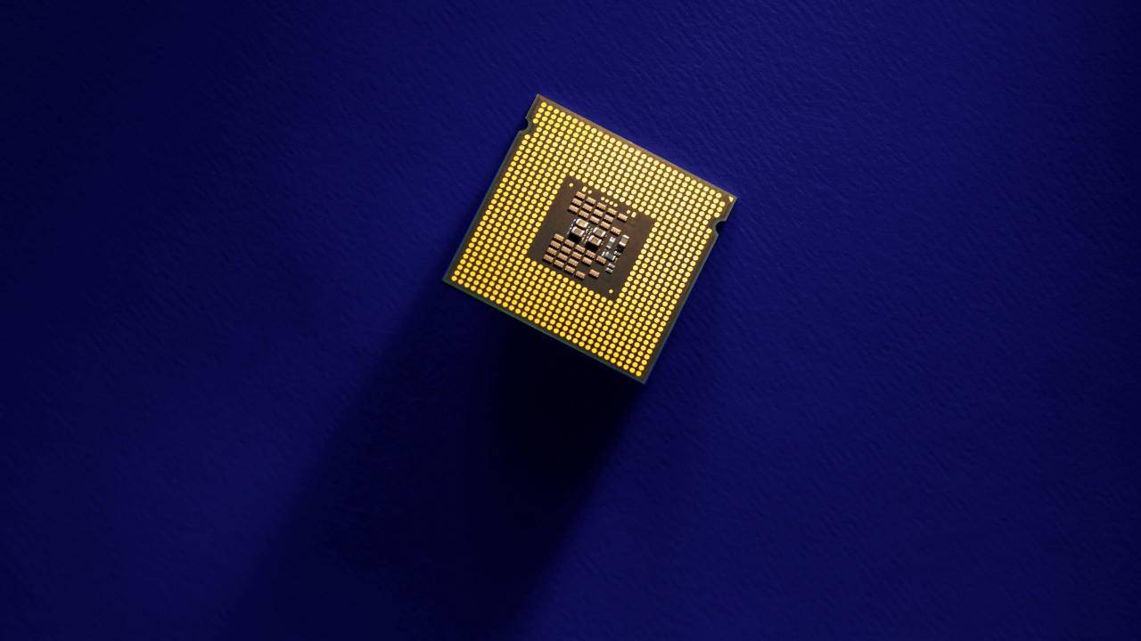
Who we are
R&D Center
Products
Production
Quality Management
Future Plans
Contents

Slide 3
Products Manufacturing
1. Who We Are

Slide 4

Kan Tsang is a leading manufacturer of audio and video products including Clock Radio and Digital Radio products, Bluetooth Speakers, Headphones, Truewireless headsets, Cordless phones, and Baby Monitors
1983
First established as trading company of acoustic components
1998
Began own manufacturing of acoustic components and modules
2006
Began manufacturing of End Products

Slide 5
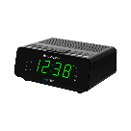
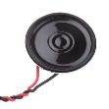

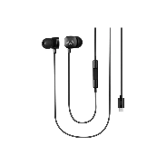
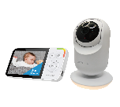
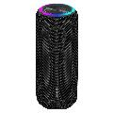
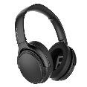

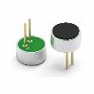
Company Milestones
Headphones
Components Trading
Kids Headphones,
ANC headphones
Volume Knobs,
Antennas, Microphones
1998
2010
2020
End Products Manufacturing Plant
Headphones
Components Manufacturing Plant
Baby Monitors,
White Noise
Machines
1983
Microphone,
Speakers
2006
Clock Radio,
Headphone,
BT speaker
2016

Slide 7
Core Competitive Advantage
Fast Time to Market even with completely new Ideas
Strong Supply chain support through reputation
Strong Independent Financial Support
Ability to Bring Innovation to Life

Slide 8
Organization Chart
Chairman
Managing Director
General Manager
Sales
R & D
OEM
Production
Administration
Finance
Components
Mechanical
Project
Management
Quality
Sourcing
End Products
Electrical
Certification
Warehouse
Software
Human
Resources

Slide 9
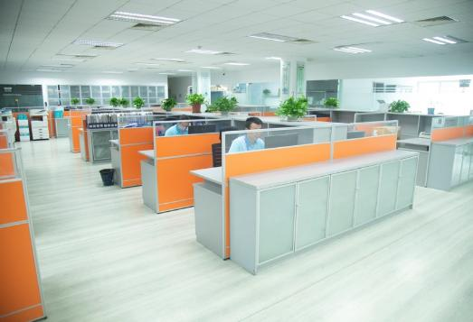

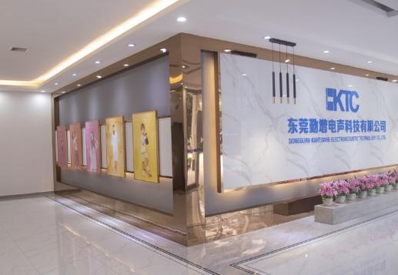
Wholly owned Property and Manufacturing site of more than 25,000 square meter

Slide 10
Products Manufacturing
2. R&D Center

Slide 11
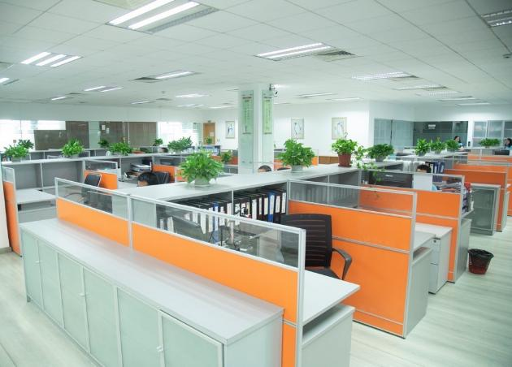
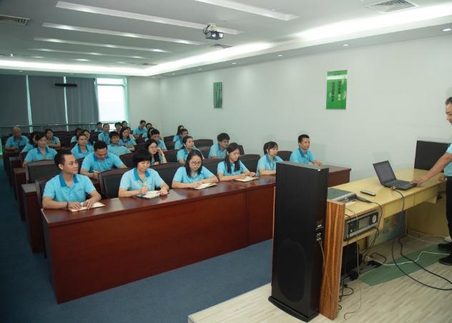
Open workspace and Staff Training facilities

Slide 12
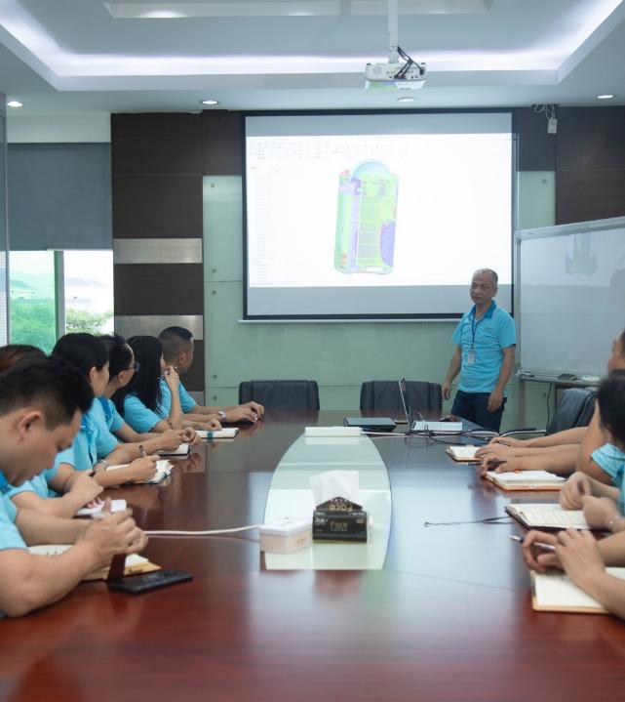
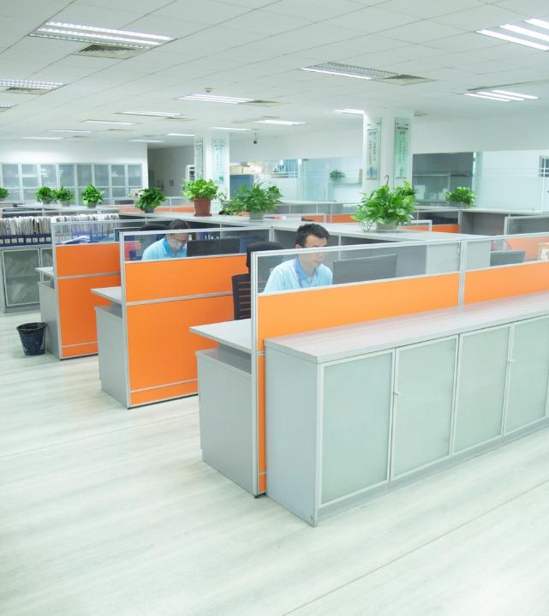
Engineering Team consisting of 20+ people including Mechanical, Electrical Software, and Production engineers

Slide 13
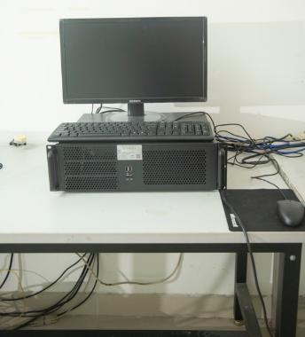
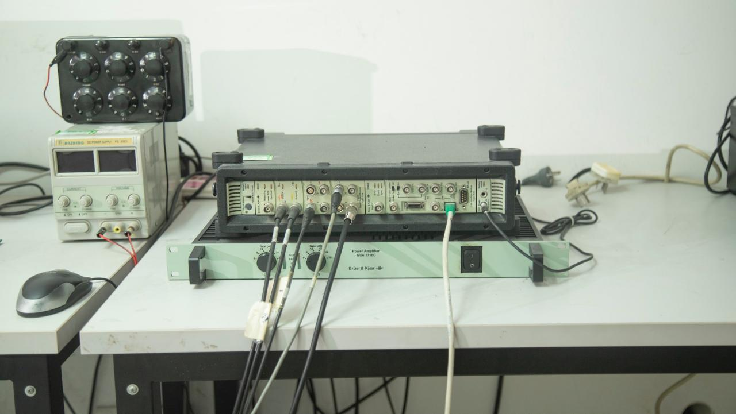
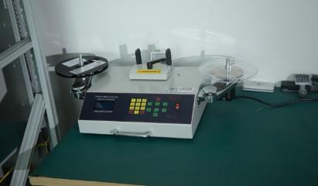
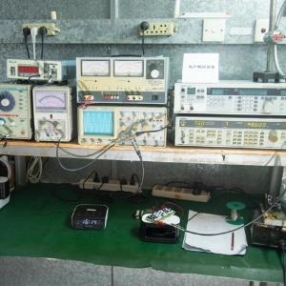
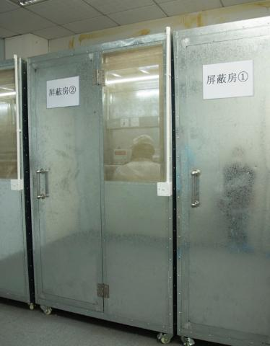
Frequency Response
Analyzer
Fully equipped R&D Center
Shielded Chamber
For RF testing

Slide 14
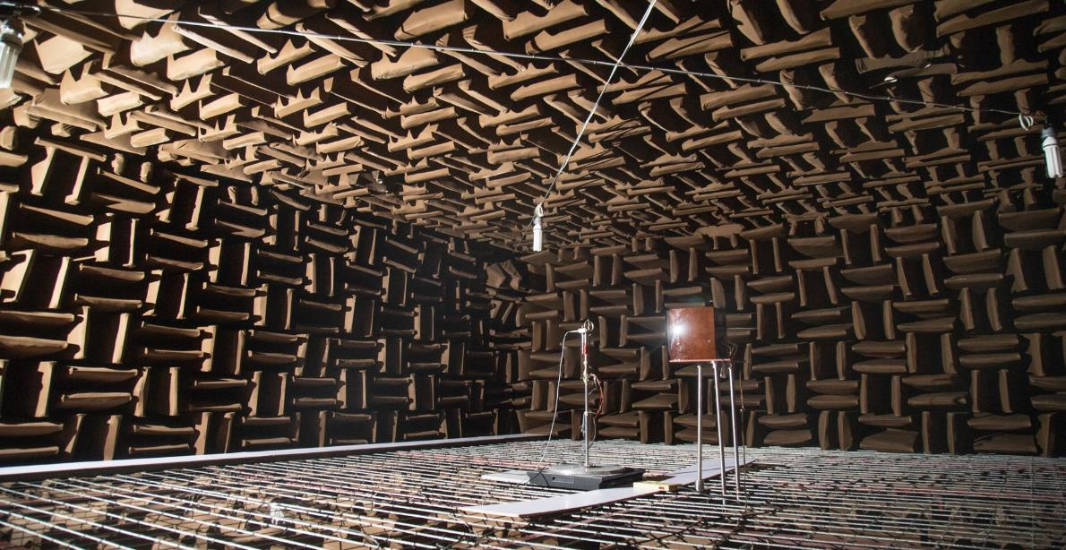
Fully Shielded Anechoic Chamber @<20dBA

Slide 15
Products Manufacturing
3. Products

Slide 16
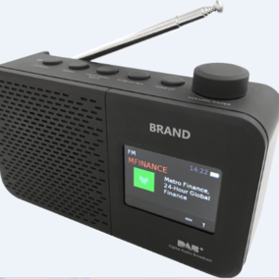
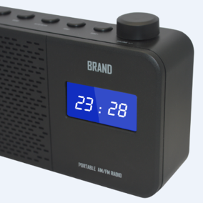
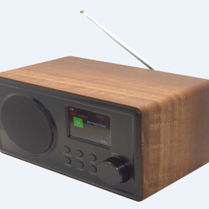
Clocks and DABs

Slide 17
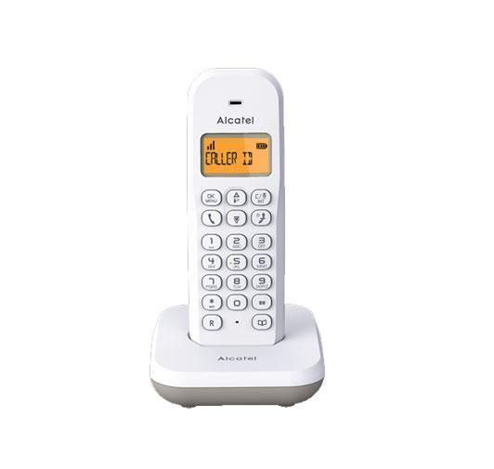
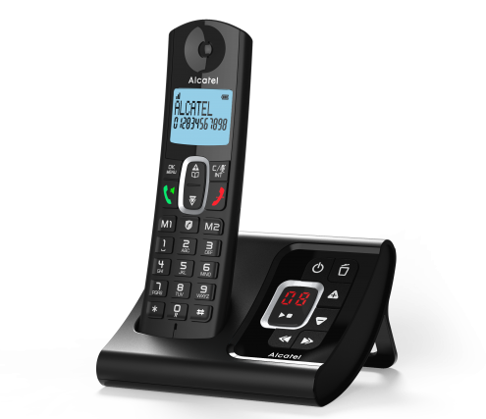
Cordless Phones

Slide 18
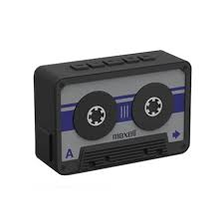
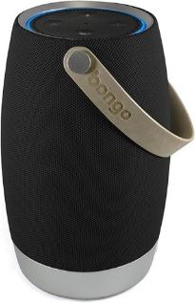
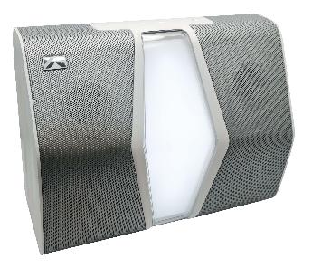
Bluetooth Speakers

Slide 19
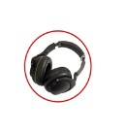
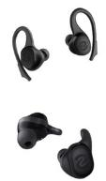

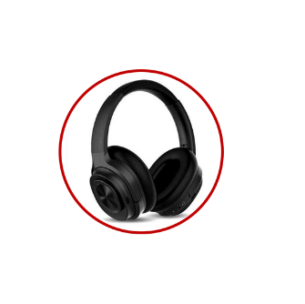
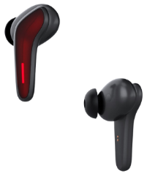
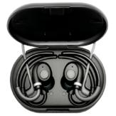
Heaphones, Active Noise Cancelling Heaphones and
Truewireless Earbuds

Slide 20
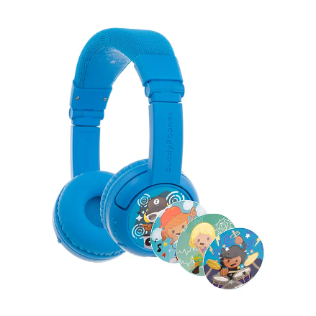
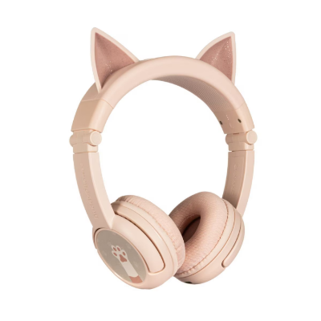
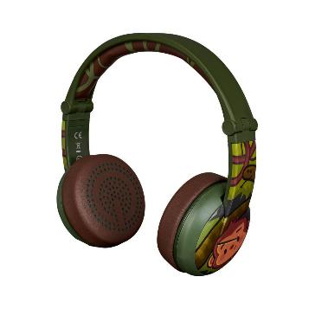
Kids Headphones

Slide 21
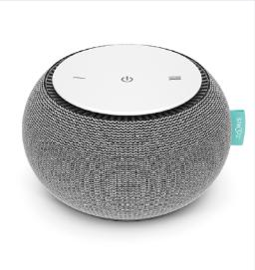
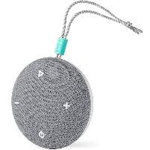
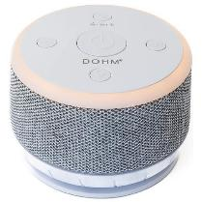
White Noise Machines

Slide 22
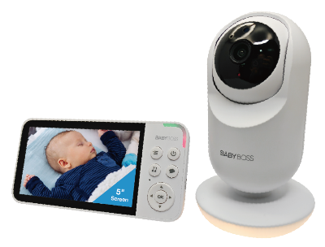
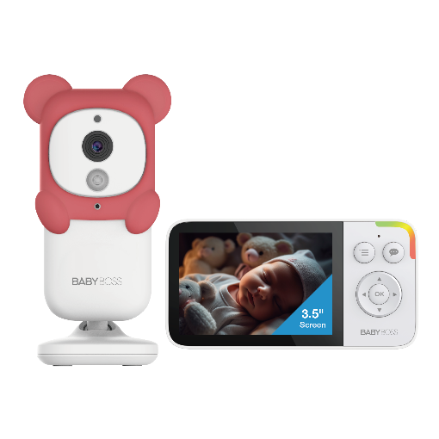
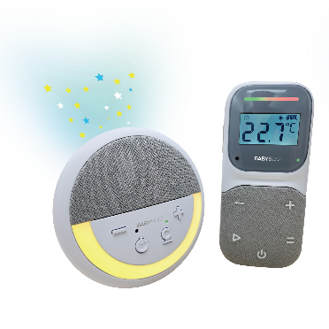
Baby Monitors

Slide 23



















Partners

Slide 24
Products Manufacturing
4. Production

Slide 25
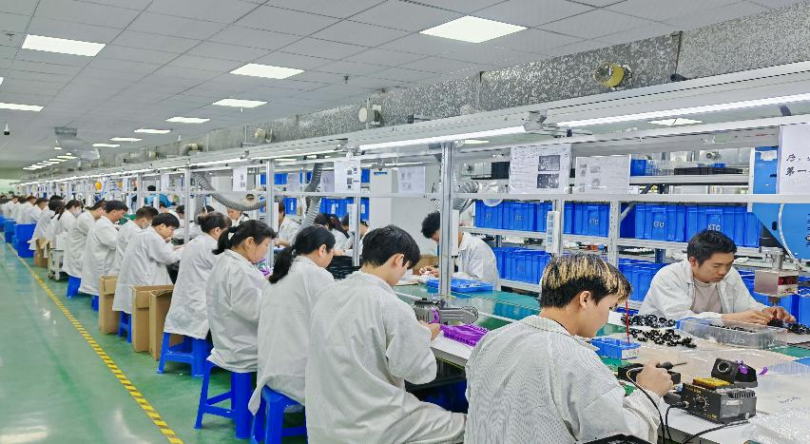
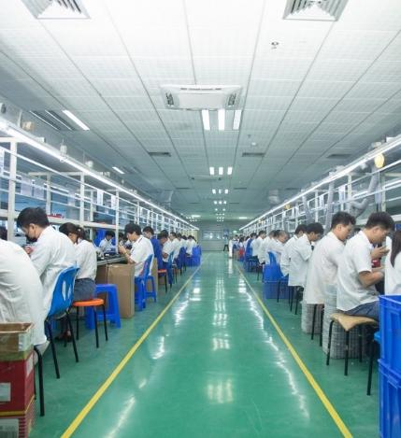
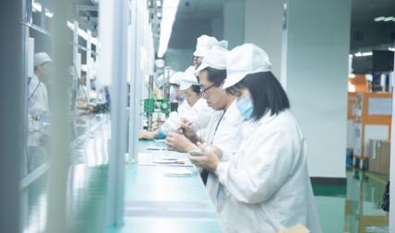
Production Line

Slide 26
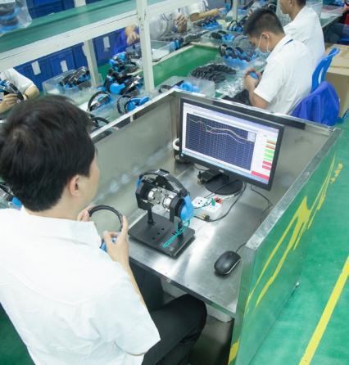
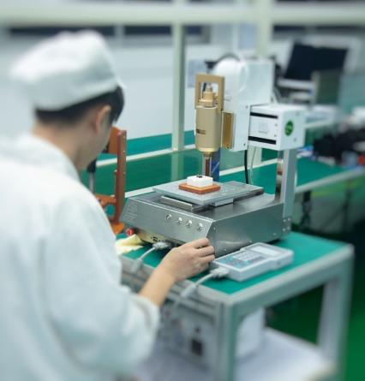
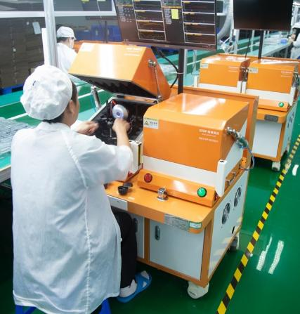
Product specific Audio Testing
Equipment
Auto Glue Station
Shielded Testing

Slide 27
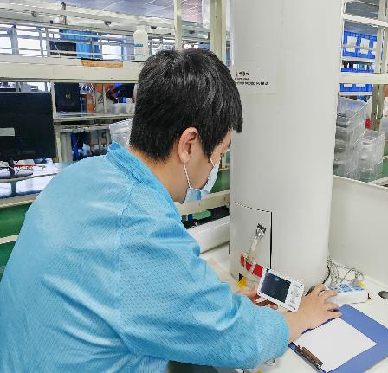
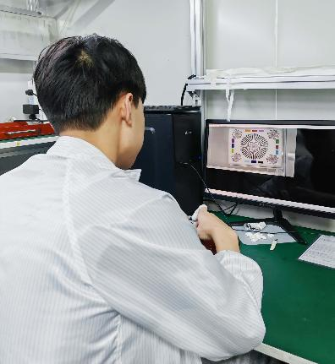

Baby Monitor
Night mode
testing
Anti-Dust Lens
Focusing Clean Room
RF Signal testing

Slide 28

Automatic Packaging Shrink Wrap

Slide 29
Products Manufacturing
5. Quality
Management

Slide 30



Reliability labs, Salt Spray, Dynamic Chambers and Drop Test Facilities

Slide 31









Headband
pulling reliability
Headphone
twisting aging
Friction Resistant Test
Headband pressure test
Acoustic
reliability test
Jack insertion aging test
Transportation Test
Cylindrical drop test
Frequency
Response
Analyzer

Slide 32

Incoming
Inspection
Quality Control
RoHs Testing equipment ensuring compliance of materials

Slide 33

ISO9001:2015, ISO14001:2015, IECQ HSPM QC080000:2012,
quality, hazardous substances and environmental system certification.​

Slide 34




Factory Approved by

Slide 35
Products Manufacturing
6. Future Plans

Slide 36
Future Plan in the next 3 years
Securing Southeast Asia Manufacturing Partner
Developing Core Technology in Headphone products in Noise
cancelling and Office use
Expansion of Connected Products surrounding Education
2025
2026
2027
Addition of new SW team to
develop AI capabilities in Baby products
Expansion of Asia Market,
Japan Market and Middle
East Market

Slide 37

Thank You for being
a Partner
Kan Tsang Group
All Rights Reserved 2021 ©

